Slide 1

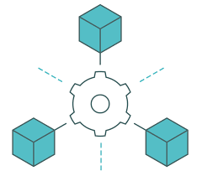

Command and Query Responsibility Segregation (CQRS)
By
Hassan FARSI & Driss ALLAKI

Slide 2

Objectives
The objective of this demo is to :
Be able to implement well adapted view databases.
Combine the Event Sourcing and CQRS patterns in one architecture.
Insure robust communication and data availability across the network.

Slide 3
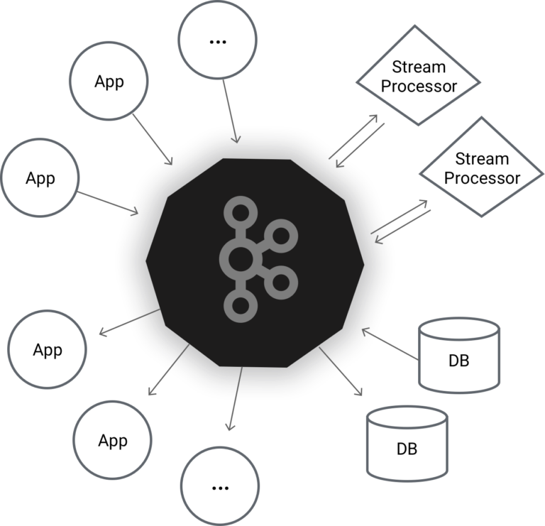

Prerequisites
Service A
Events channel
Service B
Install this
https://www.youtube.com/watch?v=P_tmrpNh12o&ab_channel=JavaShastra

Slide 4




Tweeter
Client (Browser or Postman)
(2) Get registry
<API Gateway>
Spring Cloud Gateway
<Service registry>
Eureka Netflix
User Service
Tweet Service
Follow Service
Like Service
H2 DB
H2 DB
H2 DB
H2 DB
User Info Service
H2 DB

Slide 5
What to do
users (table)
- userId - username - fullname - address - dateOfBirth
tweets (table)
- tweetId - message - pubDate - userId
follows (table)
- followOpId - followerId - followEEId - followDate
likes (table)
- likeId - userId - tweetId - LikeDate
{ "userId" : "1" "username" : "hassan123" "fullname" : "Hassan Farsi" "address" : "earth" "dateOfBirth" : "09/11/2021" "tweetsCount": 42 "followsCount": 214 "likesCount": 321 }
SELECT * FROM users WHERE user_id = ? SELECT COUNT(*) AS tweetsCount FROM tweets WHERE user_id = ? SELECT COUNT(*) AS followsCount FROM follows WHERE follower_id = ? SELECT COUNT(*) AS likesCount FROM likes WHERE user_id = ?
User service
?

Slide 6

API Composer
Client (Browser or Postman)
<API Gateway>
Spring Cloud Gateway
API Composer
It is time consuming, and even worse if using synchronous communication
(1) Get User
(3) Get likes
(2) Get Tweets
(3) Get Follows
User Service
Tweet Service
Follow Service
Like Service
H2 DB
H2 DB
H2 DB
H2 DB

Slide 7


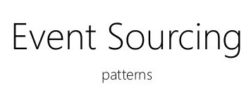
What to do
User Info Service
H2 DB
{ "userId" : 1, "username" : "hassan123“, "fullname" : "Hassan Farsi“, "address" : "earth“, "dateOfBirth" : "09/11/2021“, "tweetsCount": 42, "followsCount": 214, "likesCount": 321 }

Slide 8

No Exception Handler
Example :
- Add a tweet for a user that does not exist.
- Follow the same user multiple times.
- Like the same tweet twice or more.
- Like or follow by a user that does not exist.
- Etc.
Solution : We can always use SAGA pattern.
Tweet Service
User Service
SAGA
H2 DB
H2 DB
No Exception Handler

Slide 9
The process
Step 1 : Create a multi module project with 5 modules, each represents a separate service (User-Service ; Tweet-Service ; Follow-Service ; Like-Service ; User-Info-Service).
Step 2 : For each module, in the pom.xml file change the parent tag to the actual spring boot parent project.
Step 3 : Define the Data Transfer Objects (DTOs) module. Then create some events (The DTOs are : UserEvent, TweetEvent, FollowEvent, LikeEvent). Then add the DTOs project dependency to all the other services (pom.xml).
Step 4 : In each service defines the necessary JPA entities with the appropriate annotations.
Step 5 : Define each service controller and service layer, along with the event publisher and the Kafka configuration (Do not forget the application.yaml file properties).
Step 6 : Define the User-Info-Service consumer and update its database.
Step 7 : Run and test.

Slide 10

STEP 1

Slide 11

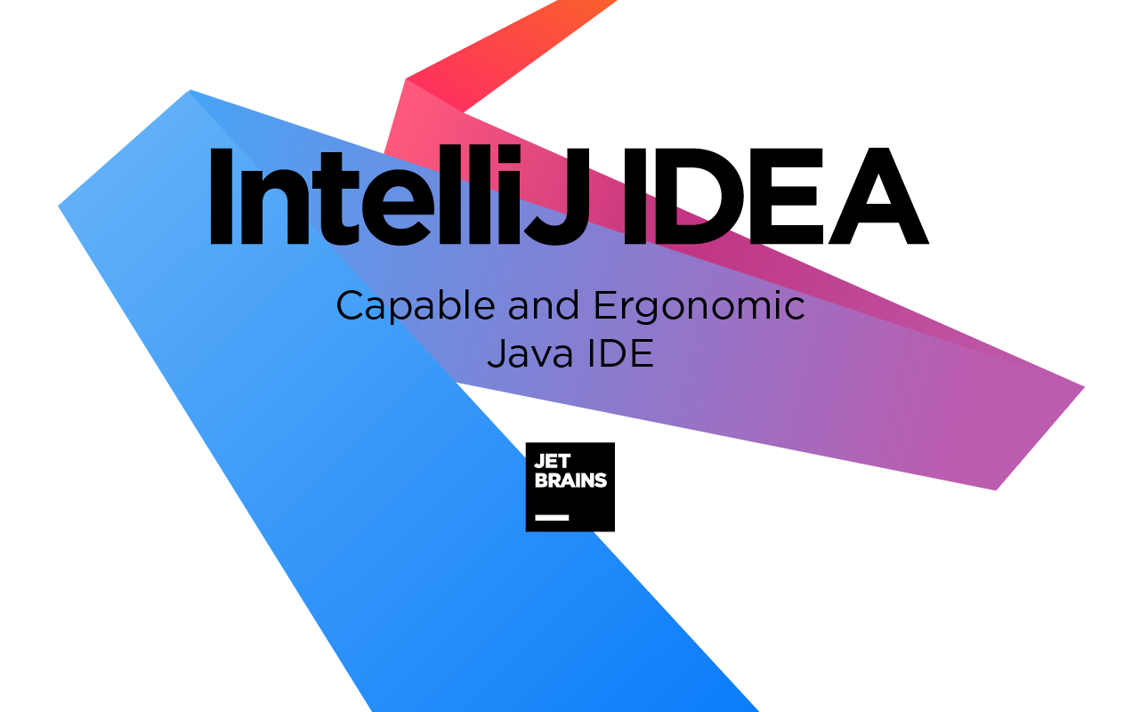

Step 1 : Multi module project
Intellij
Eclipse

Slide 12
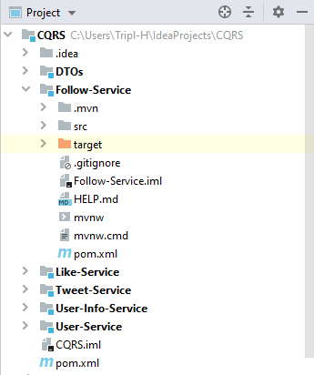
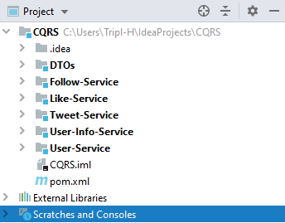
Step 1 : Multi module project
CQRS Project
CQRS Project
Follow-Service module
A simple spring boot project
Modules (Services)
Pox.xml file of the parent project (CQRS)
https://medium.com/macoclock/how-create-multi-module-project-in-intellij-on-macos-50f07e52b7f9

Slide 13
STEP 2

Slide 14
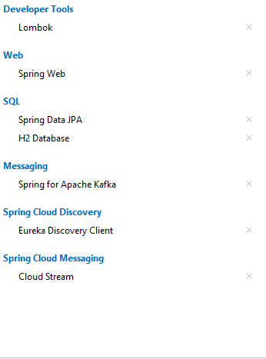
Step 2 : Dependencies
Change each module pom.xml file parent tag to fit the root project information.
Modules will inherit all root dependencies.
<parent> <groupId>com.CQRS</groupId> <artifactId>demo</artifactId> <version>0.0.1-SNAPSHOT</version> <relativePath/> <!-- lookup parent from repository --> </parent>
<!-- https://mvnrepository.com/artifact/org.rocksdb/rocksdbjni --> <dependency> <groupId>org.rocksdb</groupId> <artifactId>rocksdbjni</artifactId> <version>6.25.3</version> </dependency>

Slide 15
STEP 3

Slide 16
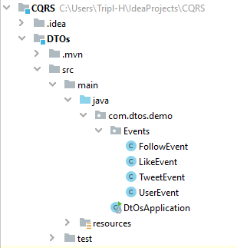
Step 2 : Data Transfer Objects (DTOs) module
@Data public class FollowEvent { private final UUID id; private final Long followOpId; private final Long followerId; }
@Data public class TweetEvent { private final UUID id; private final Long tweetId; private final Long userId; }
@Data public class LikeEvent { private final UUID id; private final Long likeId; private final Long userId; }
@Data public class UserEvent { private final UUID id; private final Long userId; private final String username; private final String fullname; private final String address; private final Date dateOfBirth; }
<dependency> <groupId>com.DTOs</groupId> <artifactId>demo</artifactId> <version>0.0.1-SNAPSHOT</version> </dependency>
DTOs module

Slide 17
STEP 4

Slide 18
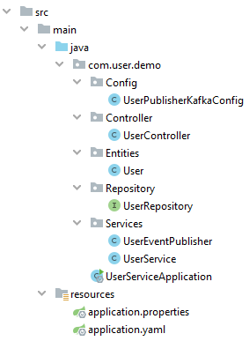
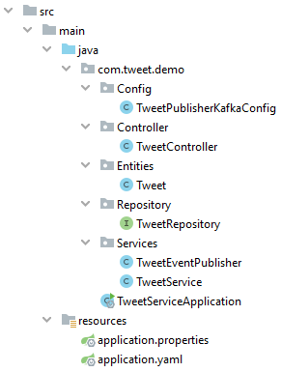
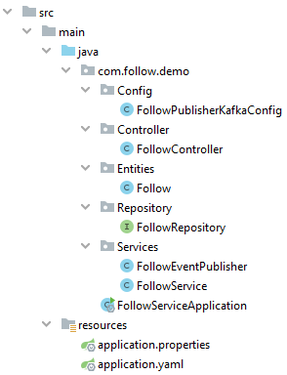
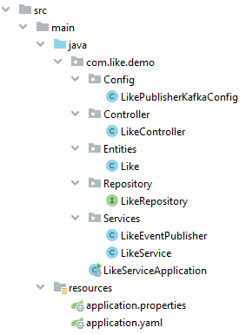
Step 4: JPA entities (Modules structure)
User-Service
Tweet-Service
Follow-Service
Like-Service
Note : Change All modules finale structure (In order to have a full vision)

Slide 19

Step 4: JPA entities (User-Service)
@Entity @Data public class User { @Id @GeneratedValue(strategy = GenerationType.IDENTITY) private Long userId; private String username; private String fullname; private String address; private Date dateOfBirth; }
A user
public interface UserRepository extends JpaRepository<User, Long> { }
User-Service

Slide 20

Step 4: JPA entities (Tweet-Service)
@Entity @Data public class Tweet { @Id @GeneratedValue(strategy = GenerationType.IDENTITY) private Long tweetId; private String message; private Date pubDate; private Long userId; }
A tweet
public interface TweetRepository extends JpaRepository<Tweet, Long> { }
Tweet-Service

Slide 21

Step 4: JPA entities (Follow-Service)
@Entity @Data public class Follow { @Id @GeneratedValue(strategy = GenerationType.IDENTITY) private Long followOpId; private Long followerId; private Long followEEId; private Date followDate; }
A follow
public interface FollowRepository extends JpaRepository<Follow, Long> { }
Follow-Service

Slide 22

Step 4: JPA entities (Like-Service)
@Entity @Table(name="LikeTable") @Data public class Like { @Id @GeneratedValue(strategy = GenerationType.IDENTITY) private Long likeId; private Long userId; private Long tweetId; private Date LikeDate; }
A like
public interface LikeRepository extends JpaRepository<Like, Long> { }
Like-Service

Slide 23
STEP 5

Slide 24
Step 5 : User-Service (Controller and service layer)
@RestController public class UserController { @Autowired private UserService userService; @GetMapping("/{userId}") public User getUserById(@PathVariable long userId){ return userService.getUserById(userId); } @PostMapping("/newUser") public User AddUser(@RequestBody User newUser){ return userService.addNewUser(newUser); } }
@Service public class UserService { @Autowired private UserEventPublisher userEventPublisher; @Autowired private UserRepository userRepository; public User getUserById(long userId){ return userRepository.findById(userId).get(); } public User addNewUser(User newUser){ userRepository.save(newUser); userEventPublisher.publishUserEvent(newUser); return newUser; } }
User-Service (Controller)
User-Service (Service Layer)

Slide 25
Step 5 : User-Service (Event publisher and the kafka configuration )
@Service public class UserEventPublisher { @Autowired private Sinks.Many<UserEvent> userSinks; public void publishUserEvent(User newUser){ UserEvent userEvent = new UserEvent( UUID.randomUUID(), newUser.getUserId(), newUser.getUsername(), newUser.getFullname(), newUser.getAddress(), newUser.getDateOfBirth() ); userSinks.tryEmitNext(userEvent); } }
@Configuration public class UserPublisherKafkaConfig { @Bean public Sinks.Many<UserEvent> userSinks(){ return Sinks.many()
.multicast()
.onBackpressureBuffer(); } @Bean public Supplier<Flux<UserEvent>> userSupplier(
Sinks.Many<UserEvent> sinks){ return sinks::asFlux; } }
User-Service (Kafka config)
User-Service (Event publisher )

Slide 26
Step 5 : Tweet-Service (Controller and service layer)
@Service public class TweetService { @Autowired private TweetRepository tweetRepository; @Autowired private TweetEventPublisher tweetEventPublisher; public Tweet getTweetById(long tweetId){ return tweetRepository.findById(tweetId).get(); } public Tweet addNewTweet(Tweet newTweet){ tweetRepository.save(newTweet); tweetEventPublisher.publishTweetEvent(newTweet); return newTweet; } }
@RestController public class TweetController { @Autowired private TweetService tweetService; @GetMapping("/{tweetId}") public Tweet getTweetById(@PathVariable long tweetId){ return tweetService.getTweetById(tweetId); } @PostMapping("/newTweet") public Tweet AddTweet(@RequestBody Tweet newTweet){ return tweetService.addNewTweet(newTweet); } }
Tweet-Service (Controller)
Tweet-Service (Service Layer)

Slide 27
Step 5 : Tweet-Service (Event publisher and the kafka configuration )
@Service public class TweetEventPublisher { @Autowired private Sinks.Many<TweetEvent> tweetSinks; public void publishTweetEvent(Tweet newTweet){ TweetEvent tweetEvent = new TweetEvent( UUID.randomUUID(), newTweet.getTweetId(), newTweet.getUserId() ); tweetSinks.tryEmitNext(tweetEvent); } }
@Configuration public class TweetPublisherKafkaConfig { @Bean public Sinks.Many<TweetEvent> tweetSinks(){ return Sinks.many()
.multicast()
.onBackpressureBuffer(); } @Bean public Supplier<Flux<TweetEvent>> tweetSupplier(
Sinks.Many<TweetEvent> sinks){ return sinks::asFlux; } }
Tweet-Service (Event publisher )
Tweet-Service (Kafka config)

Slide 28
Step 5 : Follow-Service (Controller and service layer)
@Service public class FollowService { @Autowired private FollowRepository followRepository; @Autowired private FollowEventPublisher followEventPublisher; public Follow getFollowById(long followId){ return followRepository.findById(followId).get(); } public Follow addNewFollow(Follow newFollow){ followRepository.save(newFollow); followEventPublisher.publishFollowEvent(newFollow); return newFollow; } }
@RestController public class FollowController { @Autowired private FollowService followService; @GetMapping("/{followId}") public Follow getFollowById(
@PathVariable long followId){ return followService.getFollowById(followId); } @PostMapping("/newFollow") public Follow AddFollow(@RequestBody Follow newFollow){ return followService.addNewFollow(newFollow); } }
Follow-Service (Controller)
Follow-Service (Service Layer)

Slide 29
Step 5 : Follow-Service (Event publisher and the kafka configuration )
@Service public class FollowEventPublisher { @Autowired private Sinks.Many<FollowEvent> followSinks; public void publishFollowEvent(Follow newFollow){ FollowEvent followEvent = new FollowEvent( UUID.randomUUID(), newFollow.getFollowOpId(), newFollow.getFollowerId() ); followSinks.tryEmitNext(followEvent); } }
@Configuration public class FollowPublisherKafkaConfig { @Bean public Sinks.Many<FollowEvent> followSinks(){ return Sinks.many()
.multicast()
.onBackpressureBuffer(); } @Bean public Supplier<Flux<FollowEvent>> followSupplier(
Sinks.Many<FollowEvent> sinks){ return sinks::asFlux; } }
Follow-Service (Event publisher )
Follow-Service (Kafka config)

Slide 30
Step 5 : Like-Service (Controller and service layer)
@Service public class LikeService { @Autowired private LikeRepository likeRepository; @Autowired private LikeEventPublisher likeEventPublisher; public Like getLikeById(long likeId){ return likeRepository.findById(likeId).get(); } public Like addNewLike(Like newLike){ likeRepository.save(newLike); likeEventPublisher.publishLikeEvent(newLike); return newLike; } }
@RestController public class LikeController { @Autowired private LikeService likeService; @GetMapping("/{likeId}") public Like getLikeById(@PathVariable long likeId){ return likeService.getLikeById(likeId); } @PostMapping("/newLike") public Like AddLike(@RequestBody Like newLike){ return likeService.addNewLike(newLike); } }
Like-Service (Controller)
Like-Service (Service Layer)

Slide 31
Step 5 : Like-Service (Event publisher and the kafka configuration )
@Service public class LikeEventPublisher { @Autowired private Sinks.Many<LikeEvent> likeSinks; public void publishLikeEvent(Like newLike){ LikeEvent likeEvent = new LikeEvent( UUID.randomUUID(), newLike.getLikeId(), newLike.getUserId() ); likeSinks.tryEmitNext(likeEvent); } }
@Configuration public class LikePublisherKafkaConfig { @Bean public Sinks.Many<LikeEvent> likeSinks(){ return Sinks.many()
.multicast()
.onBackpressureBuffer(); } @Bean public Supplier<Flux<LikeEvent>> likeSupplier(
Sinks.Many<LikeEvent> sinks){ return sinks::asFlux; } }
Like-Service (Event publisher )
Like-Service (Kafka config)

Slide 32
Step 5 : application files (.properties / yaml)
spring: cloud: stream: function: definition: followSupplier bindings: followSupplier-out-0: destination: follow-event
spring: cloud: stream: function: definition: likeSupplier bindings: likeSupplier-out-0: destination: like-event
server.port=8094 spring.application.name=User-Service spring.cloud.discovery.enabled=true eureka.client.service-url.defaultZone:
http://localhost:8761/eureka/ spring.h2.console.enabled=true logging.level.org.hibernate.SQL=debug logging.level.org.hibernate.type.descriptor.sql=trace
Follow-Service
Like-Service
spring: cloud: stream: function: definition: userSupplier bindings: userSupplier-out-0: destination: user-event
spring: cloud: stream: function: definition: tweetSupplier bindings: tweetSupplier-out-0: destination: tweet-event
User-Service
Each service owns its application.properties file along with other application.yaml file to configure the kafka topics.
Above we have one example for the user-service application.properties
User-Service
Tweet-Service

Slide 33
STEP 6

Slide 34
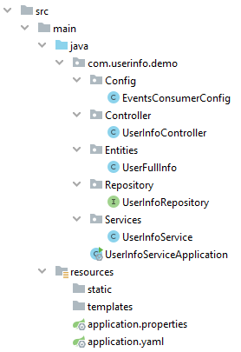
Step 6: User-Info-Service
@Entity @Data public class UserFullInfo { @Id private Long userId; private String username; private String fullname; private String address; private Date dateOfBirth; private int tweetsCount; private int followsCount; private int likesCount; }
@RestController public class UserInfoController { @Autowired private UserInfoService userInfoService; @GetMapping("/{userInfoId}") public UserFullInfo getUserInfoById(
@PathVariable long userInfoId){ return userInfoService
.getUserInfoById(userInfoId); } }
User-Info-Service JPA Entity
User-Info-Service Controller
public interface UserInfoRepository extends JpaRepository<UserFullInfo, Long> { }
User-Info-Service
User-Info-Service Repository

Slide 35
Step 6: User-Info-Service (Service Layer1)
public UserFullInfo UserFullInfoEventToUserEntity (UserEvent userEvent){ UserFullInfo userTmp = new UserFullInfo(); userTmp.setUserId( userEvent.getUserId()); userTmp.setUsername( userEvent.getUsername()); userTmp.setFullname( userEvent.getFullname()); userTmp.setAddress( userEvent.getAddress()); userTmp.setDateOfBirth( userEvent.getDateOfBirth()); return userTmp; }
User-Info-Service (Service Layer2)

Slide 36
Step 6: User-Info-Service (Service Layer2)
@Service public class UserInfoService { @Autowired private UserInfoRepository userInfoRepository; public UserFullInfo getUserInfoById(long userId){ return userInfoRepository.findById(userId).get(); }
public void updateUserData(UserEvent userEvent){ UserFullInfo userUpdate = this.UserFullInfoEventToUserEntity(userEvent); userInfoRepository.save(userUpdate); } public void updateFollowForUser(FollowEvent followEvent){ // get the user from the DB. Change the follows count, then save it again } public void updateTweetForUser(TweetEvent tweetEvent){ // get the user from the DB. Change the tweets count, then save it again } public void updateLikeForUser(LikeEvent likeEvent){ // get the user from the DB. Change the like count, then save it again }
. . . . . . UserFullInfoEventToUserEntity() -→ Next Slide
}
User-Info-Service (Service Layer)

Slide 37
Step 6: User-Info-Service (Kafka config)
@Configuration public class EventsConsumerConfig { @Autowired private UserInfoService userInfoService; @Bean public Consumer<UserEvent> userEventConsumer(){ return (userEvent) -> userInfoService.updateUserData(userEvent); } @Bean public Consumer<FollowEvent> followEventConsumer(){ return (followEvent) -> userInfoService.updateFollowForUser(followEvent); } @Bean public Consumer<TweetEvent> tweetEventConsumer(){ return (tweetEvent) -> userInfoService.updateTweetForUser(tweetEvent); } @Bean public Consumer<LikeEvent> likeEventConsumer(){ return (likeEvent) -> userInfoService.updateLikeForUser(likeEvent); } }
User-Info-Service (Kafka config)

Slide 38
Step 6: User-Info-Service (application files)
spring: cloud: stream: function: definition: userEventConsumer;followEventConsumer;tweetEventConsumer;likeEventConsumer bindings: userEventConsumer-in-0: destination: user-event followEventConsumer-in-0: destination: follow-event tweetEventConsumer-in-0: destination: tweet-event likeEventConsumer-in-0: destination: like-event
User-Info-Service (application.yaml)

Slide 39
STEP 7

Slide 40
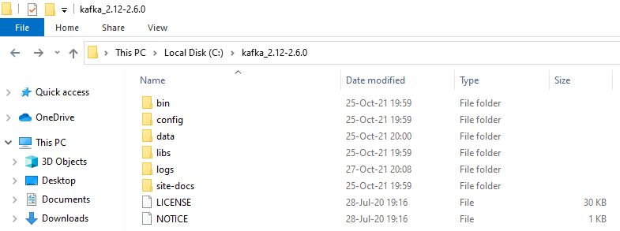
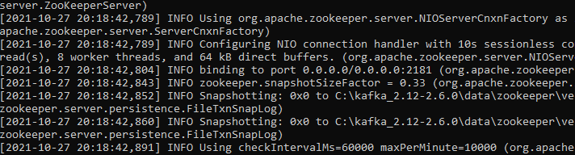
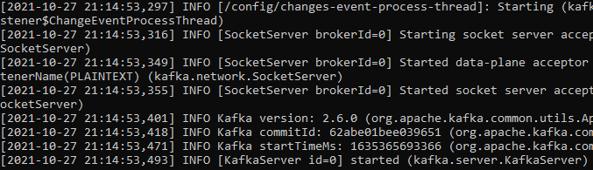
Step 7: Run and test
(2)
(1)
(3)
Before starting the server make sure that the folders data/kafka and data/zookeeper are empty.
Run the Kafka server

Slide 41
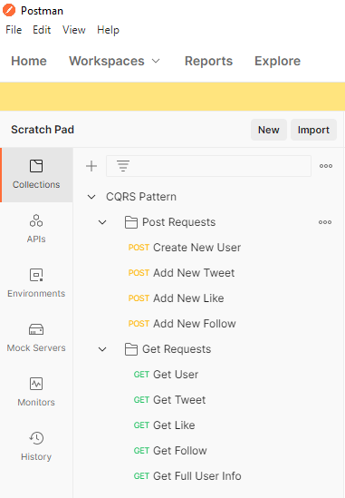
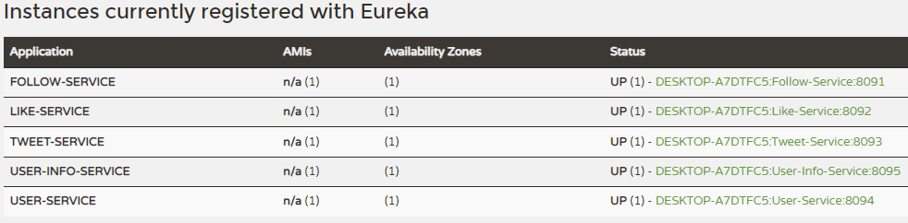
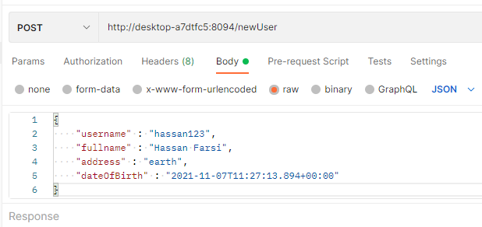
Step 7: Run and test
How to specify the
@RequestBody payload
New User

Slide 42
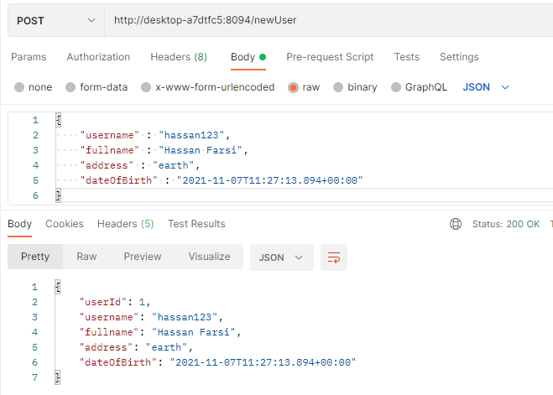
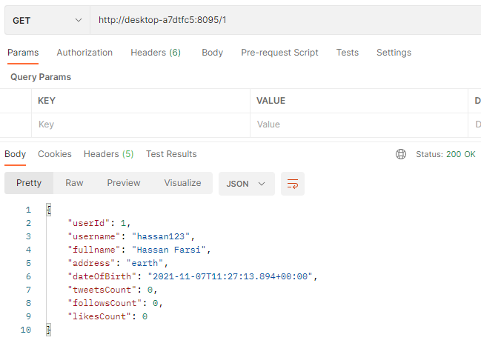
Step 7: Run and test
1) Add new user
2) Check the view DB

Slide 43
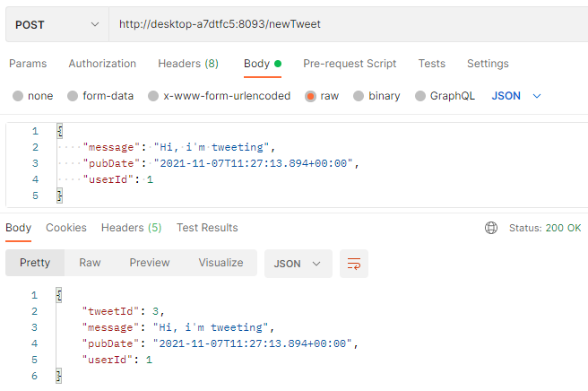
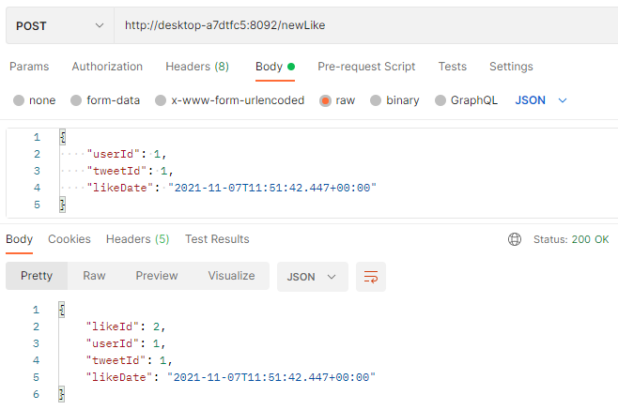
Step 7: Run and test
3) Add some tweets
4) Like some tweets

Slide 44
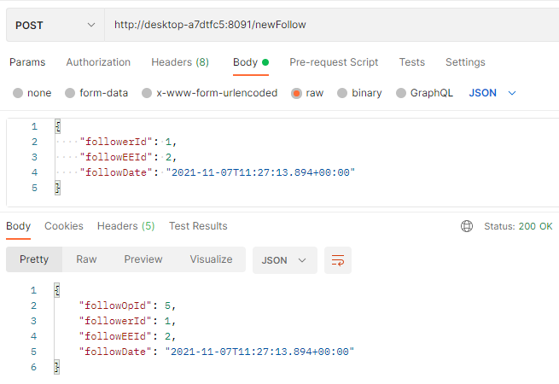
Step 7: Run and test
5) Follow some people

Slide 45
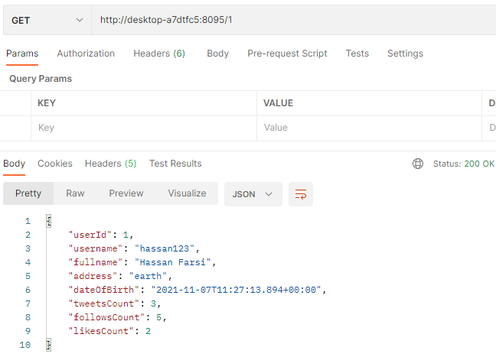
Step 7: Run and test
6) Check the view DB

Slide 46


